Slide 1

Human–Computer Interaction
Based on Chapter 16 of Bennett, McRobb and Farmer:
Object Oriented Systems Analysis and Design Using UML, (2nd Edition), McGraw Hill, 2002.

Slide 2
In This Lecture You Will Learn:
The importance of good user interface design
What is meant by metaphors in human–computer interaction
About different approaches to human–computer interaction
How to apply the techniques of scenario-based design
How standards and the law affect interface design

Slide 3
What is the User Interface?
Users of systems interact with the system to carry out tasks by:
  reading and interpreting information about how to use the system
  issuing commands to the system
  entering words and numbers into the system as data to work with
  reading and interpreting the results
  responding to and correcting errors
These are secondary tasks, not primary objectives
Notes:
It is important to note that these are secondary tasks: they are concerned with using the system not with the users’ primary objectives. In the examples in this section of this chapter, the primary tasks are to take a customer order and to find tourist information. If the system has been designed well, the secondary, system-related tasks will be easy to carry out; if it has not been designed well, the secondary tasks will intrude into the process and will make it more difficult for the users to achieve their primary tasks.

Slide 4
Metaphors
Terms used figuratively to describe something but not applied literally
Two metaphors for human–computer interaction:
  the dialogue metaphor
  the direct manipulation metaphor

Slide 5
The Dialogue Metaphor
Communication between the human and the computer is a kind of dialogue
There is no real conversation, but messages are passed from the human to the computer, the computer responds in some way, and that prompts the human to respond, and so on

Slide 6
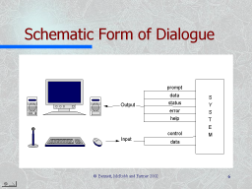
Schematic Form of Dialogue
prompt
data
S
Output
status
Y
error
S
help
T
E
control
M
Input
data

Slide 7
Types of Messages in Dialogue
Output | prompt | request for user input
 | data | data from application following user request
 | status | acknowledgment that something has happened
 | error | processing cannot continue
 | help | additional information to user
Input | control | user directs which way dialogue will proceed
 | data | data supplied by user

Slide 8
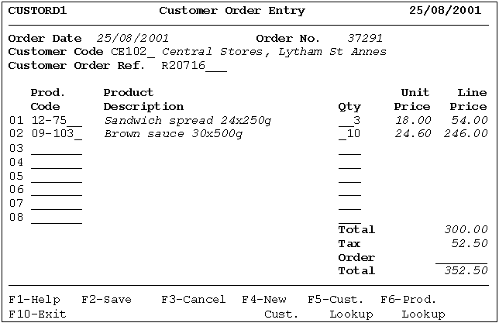
Data
Status
Prompt

Slide 9
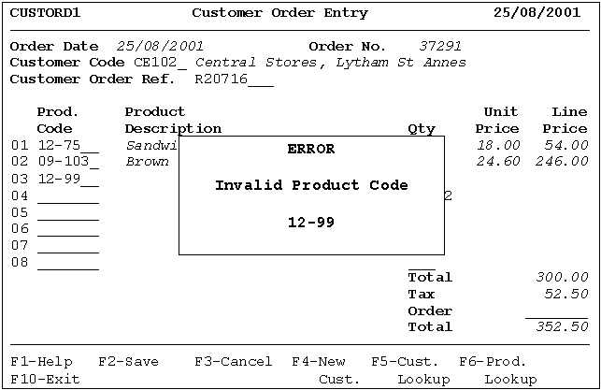
Data
Error

Slide 10
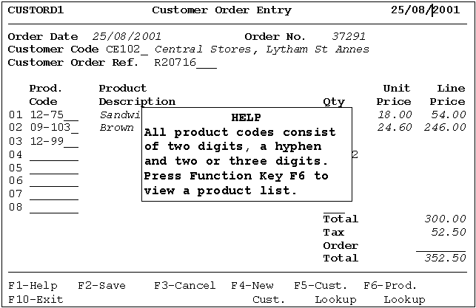
Help
Control

Slide 11
Use Cases and Dialogue
The use cases for FoodCo may document the dialogue between the user and the system
Enter customer
order
Sales Clerk

Slide 12
Use Cases for FoodCo
Enter customer
order
«include»
Find customer
View customer
order
«include»
Sales Clerk
«extend»
Print customer
order

Slide 13
The Direct Manipulation Metaphor
The interface gives the impression that you are manipulating physical objects on the screen through the use of the mouse:
  you drag and drop an icon
  you shrink or expand a window
  you push a button
  you pull down a menu

Slide 14
Event-driven Interfaces
Graphical User Interfaces (GUIs) are event-driven
The window manager responds to events and changes the state of objects in the windowing system
In a complex interface like a word-processor, the user can choose from many actions; the system has to respond correctly whichever is chosen and maintain correct state information

Slide 15
Event-driven Interfaces
Sometimes modal dialogues are used—the user can interact with only the dialogue box until he or she closes the dialogue window
Sometimes the user can be constrained by disabling and enabling elements of the interface to limit his or her choice of action

Slide 16
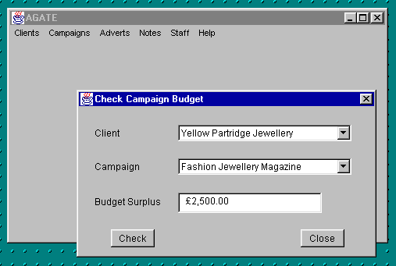
Constraining User Interaction
First the user
selects a client
Then the user
selects a
campaign
Finally the user
clicks on Check
and the budget
is displayed

Slide 17
Constraining User Interaction
It makes no sense for the user to pick a campaign if they haven’t already selected a client, or to click Check if they haven’t selected a campaign
In Chapter 17, we explain how to model the state of the interface using statechart diagrams to handle this

Slide 18
Characteristics of
Good Dialogues
Consistency
  helps users to learn the application
  even better if all applications within an organization have consistent standards
  for example, F2 always saves data
  company style guides or style guides from Microsoft and Apple can be applied

Slide 19
Characteristics of
Good Dialogues
Appropriate user support
  Provide error and warning messages
  If the user has gone wrong the dialogue should help them to set the situation right
  Avoid hidden content on web pages
  Error messages should be informative not cryptic, and use terms the user will know
  Use warning messages to prevent likely errors, but don’t overdo it and irritate users
Notes:
There are some good guidelines on the ‘Web Pages that Suck’ website, among others. Most users of websites look at what they see on the page and then decide what action to take. Hidden menus and content that pop up when the mouse rolls over something are often not helpful as users don’t move the mouse round and explore.

Slide 20
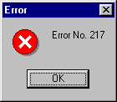
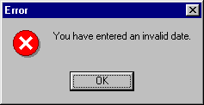
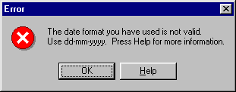
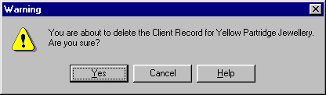
Characteristics of
Good Dialogues
Which error message is most helpful?
Is this a helpful warning?
Notes:
The warning is not ideal. Yes appears to be the default, which is risky if the user hits Return.
The question asks ‘Are you sure?’, but the answers are Yes, Cancel and Help. Would Yes, No and Help be better? Or should the question be ‘Do you wish to proceed?’?

Slide 21
Characteristics of
Good Dialogues
Adequate feedback
  The user expects some response when they press a key or click a button
  If they get no response, users tend to try again or press another key, sometimes these key presses get buffered and produce unexpected results

Slide 22
Characteristics of
Good Dialogues
Minimal user input
  Try to design systems so that users do not have to make unnecessary keypresses or mouse clicks
    Use codes and abbreviations
    Let users select from a list
    Let users edit incorrect values rather than retype them
    Provide information that can be derived automatically
    Use defaults
    Use accelerator keys for menus

Slide 23
Style Guides
Microsoft and Apple provide guidelines on design of interfaces for their platforms
Large organizations may have their own style guides
The FoodCo terminal screen earlier on reflects the company’s 1980s guide on screen design for minicomputer systems

Slide 24
Approaches to Interface Design
Design is influenced by
  nature of the task the user carries out
  type of user
  amount of training user will have received
  frequency of use
  hardware and software architecture
Approaches can be informal or formal

Slide 25
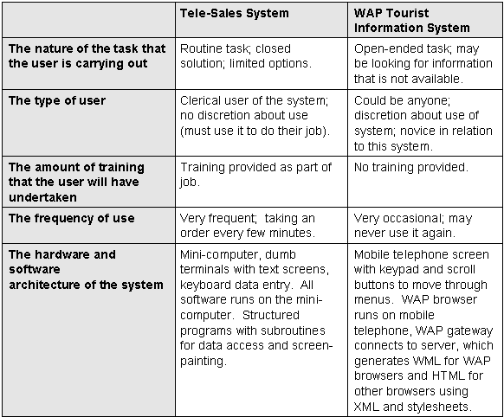

Slide 26
Approaches to Interface Design
Formal approaches include
  structured approaches
  ethnographic approaches
  scenario-based approaches
All carry out three main steps
  requirements gathering
  design of the interface
  interface evaluation

Slide 27
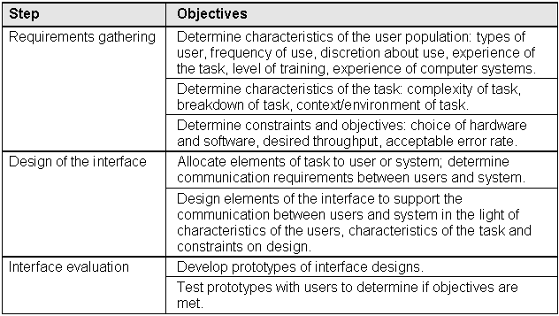

Slide 28
Structured Approaches
Relate to structured approaches to analysis and design prevalent in 1980s and early 1990s
Model life cycle as stages, steps and tasks
Allow for activities to be carried out in parallel

Slide 29
Structured Approaches
Benefits
  Breakdown into stages and steps makes project management easier
  Provide standards in diagrams and documentation that improve communication
  Specification is comprehensive and is therefore more likely to result in a good quality system

Slide 30
Structured Approaches
Concentrate on understanding tasks and allocating tasks between the users and the system
Make extensive use of checklists to characterize users, tasks and environment
STUDIO (Structured User-interface Design for Interface Optimisation) is an example

Slide 31
STUDIO
Uses a number of techniques
  task hierarchy diagrams
  knowledge representation grammars
  task allocation charts
  statecharts
See task hierarchy diagram in next slide

Slide 32
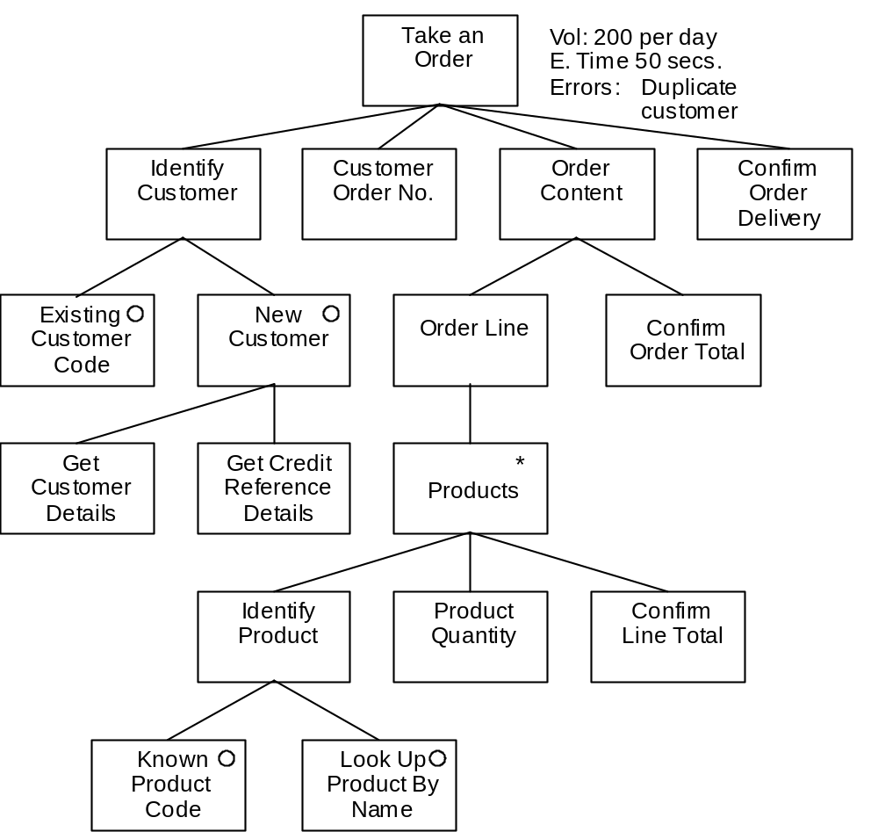

Slide 33
STUDIO
Five stages
  Project Proposal and Planning
  User Requirements Analysis
  Task Synthesis
  Usability Engineering
  User Interface Development
Notes:
See Fig 16.12, p.399 for details of stages

Slide 34
Structured Approaches
Criticisms
  Tend to be very bureaucratic, with lots of forms and checklists
  Evaluation of usability under laboratory conditions (as with RESPECT) lacks ‘ecological validity’

Slide 35
Ethnographic Approaches
Rooted in ethnographic approaches in sociology and anthropology
Researcher seeks to be involved in the situation he or she is studying
Only this way can the situation be properly understood
Qualitative rather than quantitative

Slide 36
Ethnography
‘In its most characteristic form it involves the ethnographer participating, overtly or covertly, in people’s daily lives for an extended period of time, watching what happens, listening to what is said, asking questions—in fact, collecting whatever data are available to throw light on the issues that are the focus of the research.’
(Hammersley and Atkinson, 1995)

Slide 37
Ethnographic Approaches
Interface designer needs to be immersed in the task of the users
Recognizes that different users experience the task subjectively
Criticizes some methods for failing to address the context of the task
Structured approaches respond by adding a ‘contextual analysis’ checklist

Slide 38
Contextual Enquiry
One method of ethnographic analysis
Developed by John Whiteside at DEC
Evaluates usability in normal working environment

Slide 39
Ethnographic Approaches
Use a variety of data gathering techniques, including interviews, discussions, video-taping users, prototyping
Read more on ‘Participative Design’ in Chapter 22

Slide 40
Scenario-based Approaches
Less formal than structured approaches but more formal than ethnography
Use scenarios as a tool in requirements gathering, interface design and interface evaluation
Scenarios are step-by-step descriptions of a user’s actions
Closest of the three approaches to use case modelling and fits well with it

Slide 41
Scenario-based Approaches
Scenarios can be
  textual descriptions
  storyboards
  prototypes
  video mock-ups

Slide 42
Example Scenario in Existing System
Pete starts up the word-processor.
He types in a title for the note and changes its style to Title.
He types in two paragraphs describing his idea for an advertisement for the Yellow Partridge campaign to be used in fashion magazines in Europe during the summer of 1999.
He types his initials and the date and time.
He uses the short-cut keys to save the file.
The save-as dialogue box appears and, using the mouse, he changes to the Summer 1999 Campaign folder in the Yellow Partridge folder on the server.
He scrolls to the bottom of the list of files already in the folder and reads the title of the last note to be added, Note 17, he calls the new note Note 18 and clicks on Save.
He exits from the word-processor.

Slide 43
Example Scenario for the New System
The user selects Add a Note from the menu. A new window appears.
From the list box at the top of the window she selects the name of the client.
A list of campaigns appears in the list box below, and she selects a particular campaign.
A list of adverts appears in the next list box, and she selects a specific advert.
She types a few paragraphs into a text box to describe her idea for the advert. She fills the space on screen and a vertical scrollbar appears and the text in the text box scrolls up.
She enters her initials into a text box, and the system checks that she is allocated to work on that campaign.
The date and time are displayed by the system, and the Save button is enabled.
She clicks on the Save button and the word Saved appears in the status bar.
The text box, the text field for initials and the date and time are cleared.

Slide 44
Scenario-based Approaches
Can be used (among other things) to
  gather requirements—describe what the user does now
  envision solutions—describe possible ways of working
  evaluate system—write test cases that follow scenarios
  document the system—write manual sections that follow scenarios

Slide 45
Scenario-based Approaches
Scenarios can be worked through with the users, building prototype solutions
Scenarios can be used to develop ‘design claims’ (Carroll, 1995), which justify design decisions in terms of the scenarios
If textual scenarios are used, large volumes of text result and must be managed carefully

Slide 46
Design Claims
The Save button is disabled until the user has selected a client and a campaign, entered some text and entered his or her initials. This prevents the user attempting to save the note before all data has been entered and getting an error message.
The initials of the user could be entered automatically from their network login, but observation shows that the creative staff often work together as a group and different people will come up with ideas that they record as notes. It would be inconvenient for them to be logging in and out of the system each time a different person wants to enter a new note. For this reason, they are required to enter their initials.
The initials, date, time and text fields are cleared after a note is saved, but the client, campaign and advert list boxes are left untouched so that the user can enter another note for the same advert or campaign without having to reselect these items.

Slide 47
Achieving Usability
Usability is not ‘user-friendliness’
Usability can be measured (Shackel, 1990)
  Learnability—time and effort required to achieve a particular level of performance
  Throughput—speed with which tasks can be achieved, number of errors
  Flexibility—ability to respond to changing tasks and environment
  Attitude—how positive an attitude users have

Slide 48
Standards and
Legal Requirements
International standards do not have force of law
ISO 9241—standard for ergnomic requirements for work with Visual Display Terminals
ISO 14915—standard for Multimedia User Interface Design

Slide 49
Standards and
Legal Requirements
EU Council Directive of May 1990
In the UK implemented in law as the Health and Safety (Display Screen Equipment) Regulations 1992
All workstations must comply with minimum requirements and employers have a duty in law to ensure the health and safety of employees using display screen equipment

Slide 50
Standards and
Legal Requirements
Employers are required to:
  analyse risks
  take action to reduce risks
  ensure workstations meet requirements
  plan work activities to include breaks
  provide eyesight tests for users
  provide corrective appliances for eyes
  provide relevant training
  provide information to employees

Slide 51
Standards and
Legal Requirements
Software must be suitable for task
Software must be easy to use and adaptable to the user’s knowledge and experience
Employer may not use software to check up on employees without their knowledge
Systems must give feedback to users about performance
Systems must display information suited to users
Principles of software ergonomics must be applied to the way people process data

Slide 52
Standards and
Legal Requirements
In Singapore the Ministry of Manpower published Guidelines for Work with Visual Display Unit or Visual Display Terminal (VDT) in 2000
In Hong Kong the first Regulation to be considered under the Occupational Safety and Health Ordinance (OSHO) 1997 was the Occupational Safety and Health (Display Screen Equipment) Regulation
Notes:
What is the current situation in these countries?

Slide 53
Summary
In this lecture you have learned about:
The importance of good user interface design
What is meant by metaphors in human–computer interaction
About different approaches to human–computer interaction
How to apply the techniques of scenario-based design
How standards and the law affect interface design

Slide 54
References
Shneiderman (1997)
Browne (1994)
Whiteside et al. (1988)
Carroll (1995)
(For full bibliographic details, see Bennett, McRobb and Farmer)

